Slide 1

Introduction to Python Programming
File Handling
Ms. Shital H. Dinde

Slide 2
File Handling
A file is a named location used for storing data. For example, main.py is a file that is always used to store Python code.
Python provides various functions to perform different file operations, a process known as File Handling.

Slide 3
Opening Files in Python
To open this file, we can use the open() function.
file1 = open("file1.txt”, mode)
Python allows us to open files in different modes (read, write, append, etc.), based on which we can perform different file operations.

Slide 4
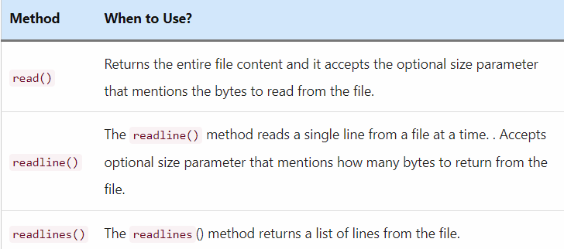
Reading Files in Python

Slide 5
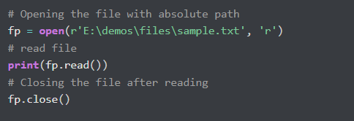
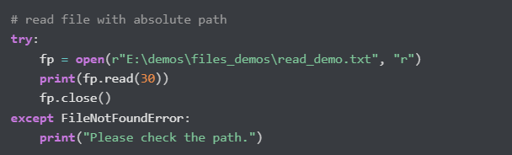

Slide 6
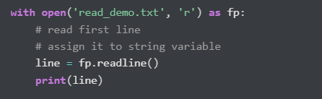
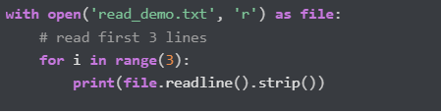

Slide 7
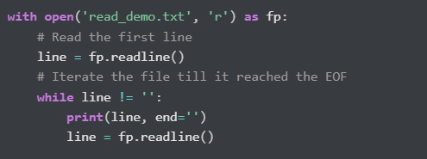
Reading Entire File Using readline()

Slide 8
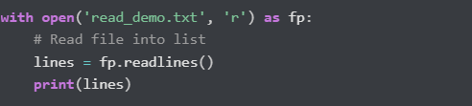

Slide 9
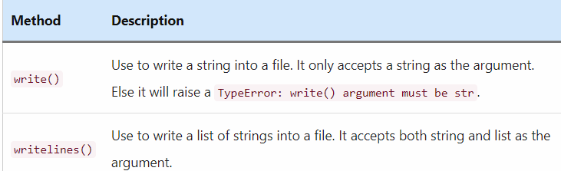
Write to Files in Python

Slide 10
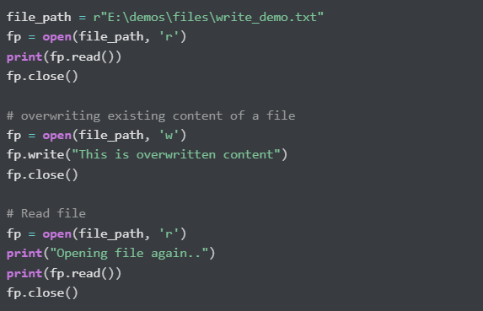

Slide 11
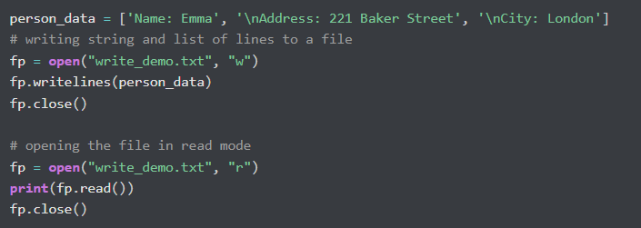

Slide 12
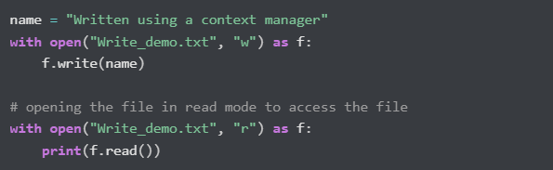

Slide 13
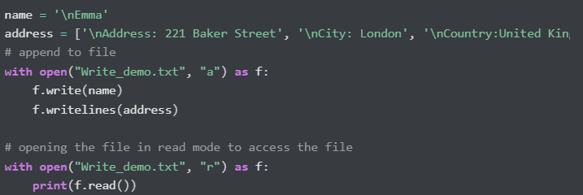

Slide 14
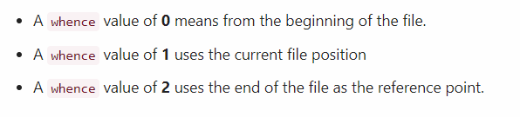
seek() Method
To change the file handle’s position use seek() method.
sets the file’s current position, and then we can read or write to the file from that position.
f.seek(offset, whence)

Slide 15
tell() Function
get the file handle current position using the tell() method.
file_object.tell()

Slide 16
1. Write a program to copy text file to another file
2. write a program to count number of lines in a file
3. Write a program to append a file with the contents of another file
4. Write a program to delete comment lines (lines beginning with a #) from a file

Slide 17


Questions?

Slide 18

8888 763 563
88 5335 4141
https://svlautomations.in
https://svltrainings.in

